Slide 1
JAVA Lecture 7
Multi-dimensional
Arrays

Slide 2
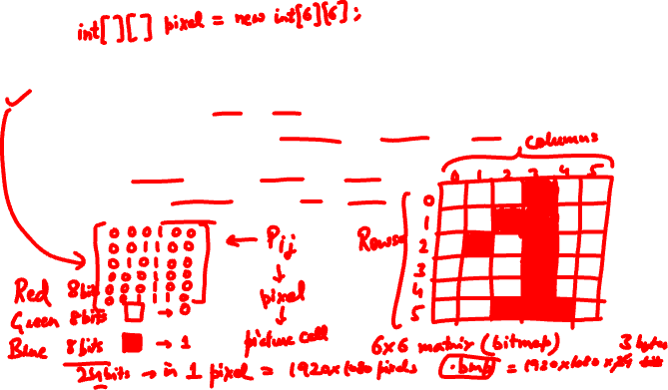
What is a Multidimensional Array?
An array containing multiple arrays as elements.
The most common type is the 2D array (matrix-like structure).
Use Cases:
Storing tabular data (e.g., student marks, matrices)
Representing game boards (e.g., chess, tic-tac-toe)
Processing image pixels

Slide 3
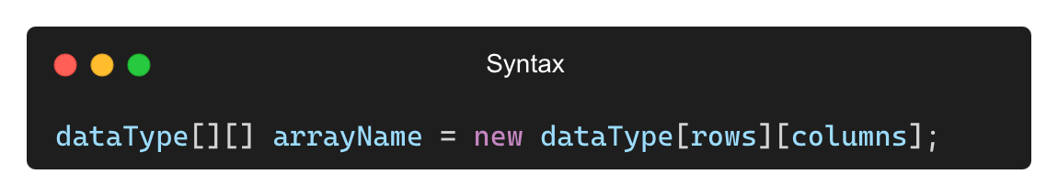
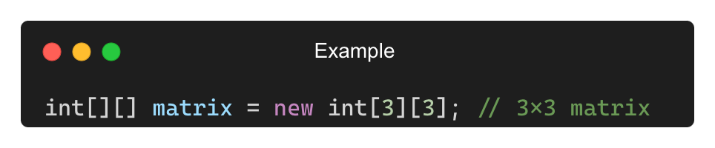
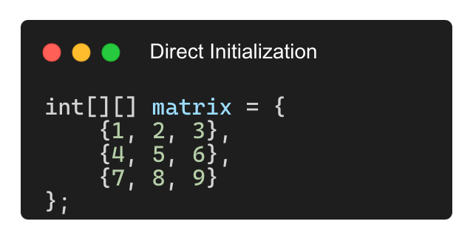
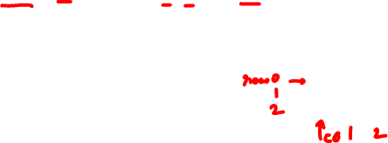
Declaring and Initializing a 2D Array

Slide 4
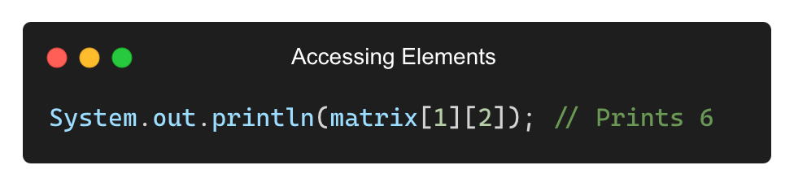
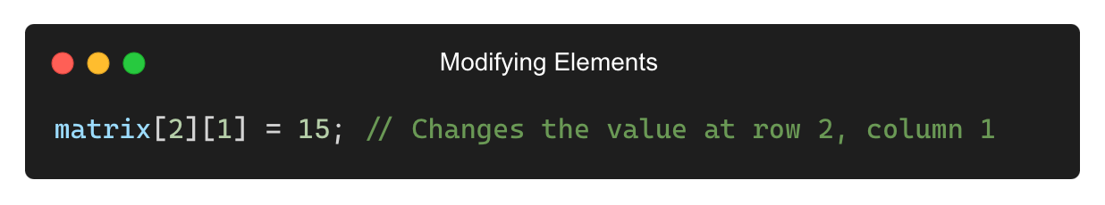
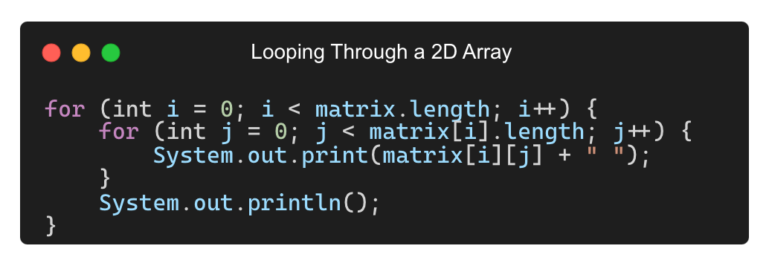
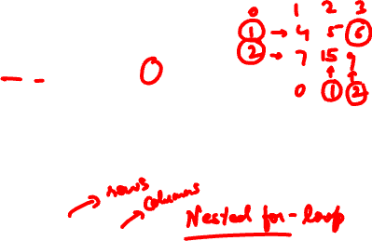
Accessing and Modifying 2D Arrays

Slide 5
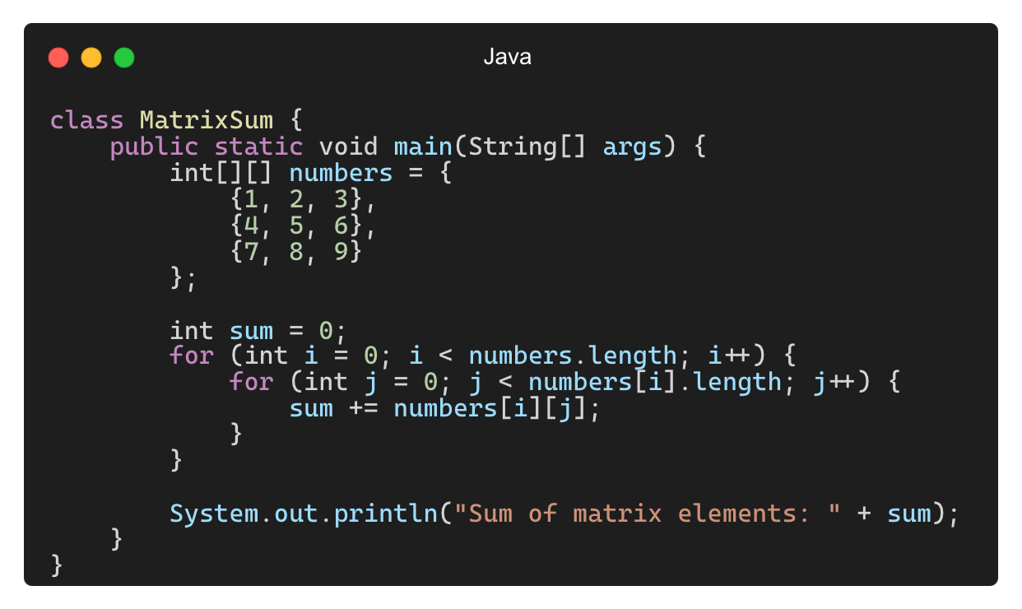
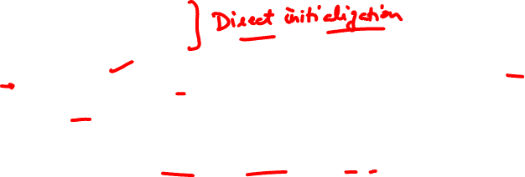
Example – Sum of Elements in a 2D Array
Output: Sum of matrix elements: 45

Slide 6
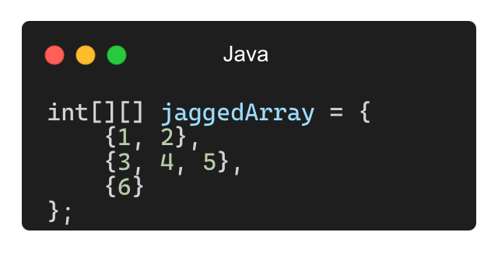
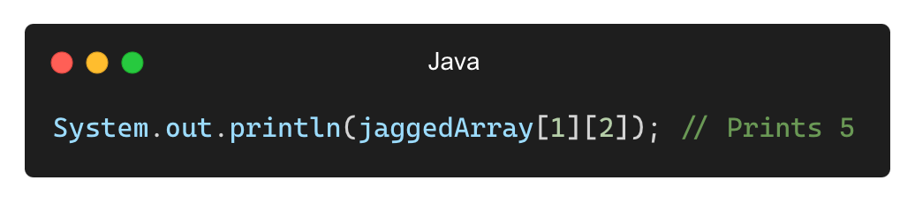

Jagged Arrays in Java
An array of arrays where each row has a different number of columns.
Accessing Elements in a Jagged Array:

Slide 7
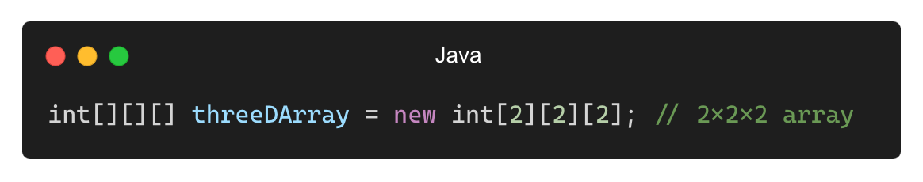
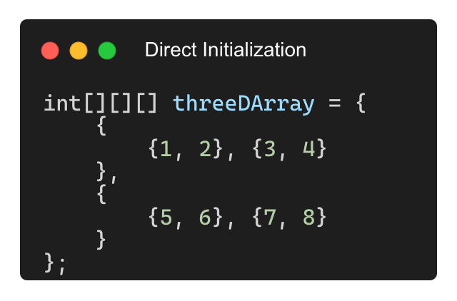
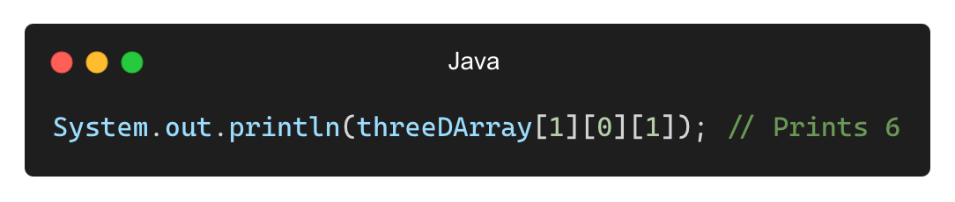
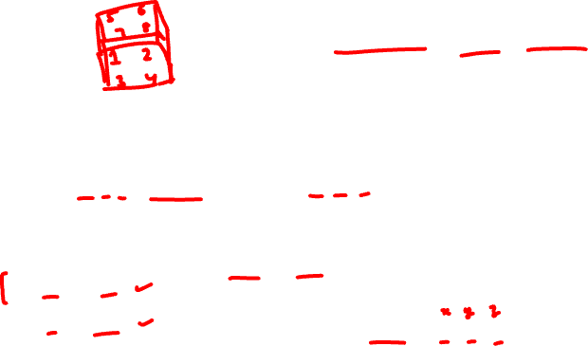
3D Arrays (Multilevel Data Storage)
A 3D array extends the concept of a 2D array by adding another dimension.
Accessing a 3D Array Element:

Slide 8
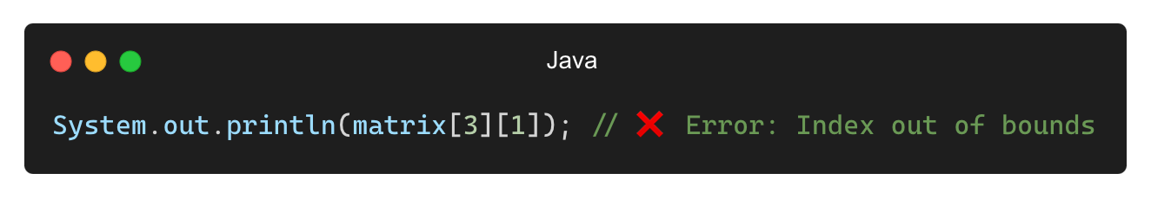
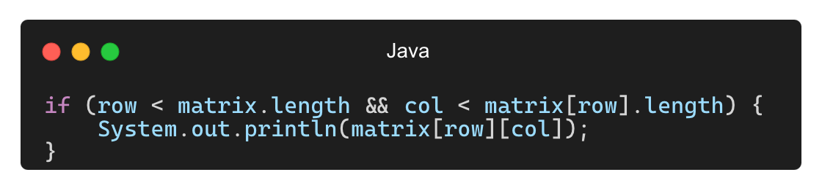
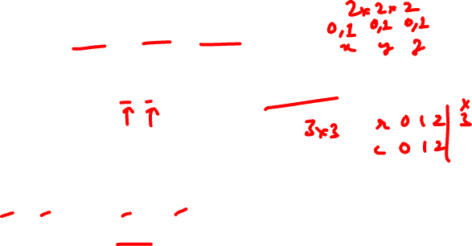
Common Mistakes with Multidimensional Arrays
❌ Incorrect Indexing (ArrayIndexOutOfBoundsException)
✅ Solution:

Slide 9
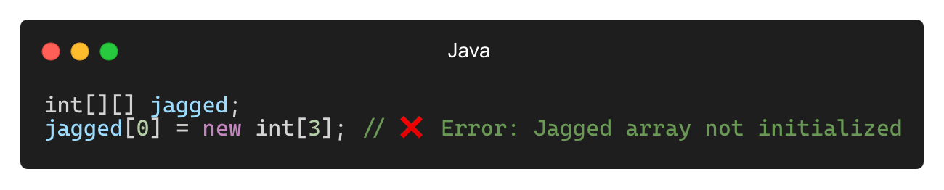
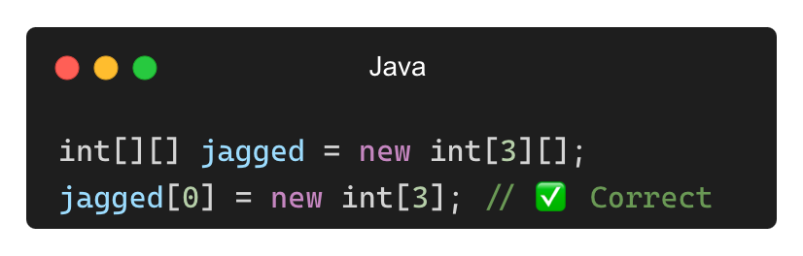
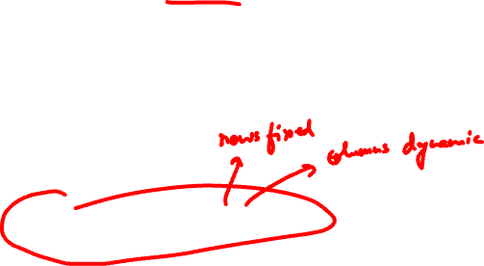
Common Mistakes with Multidimensional Arrays (Contd.)
❌ Forgetting to Initialize a Jagged Array Properly
✅ Solution:

Slide 10
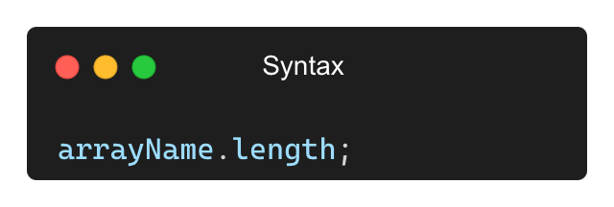
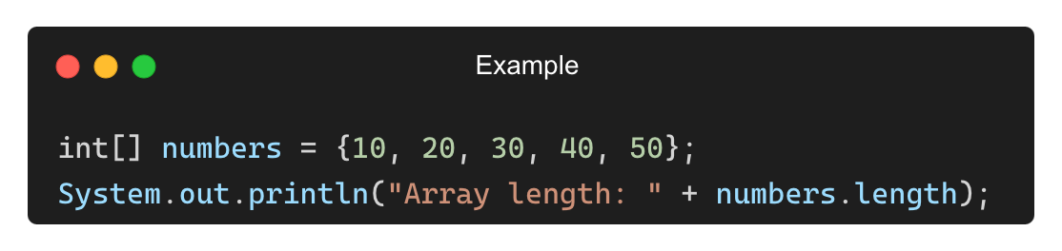
Using the length Property
The length property returns the number of elements in an array.
It is not a method, but a built-in property of arrays.
Output: Array length: 5

Slide 11
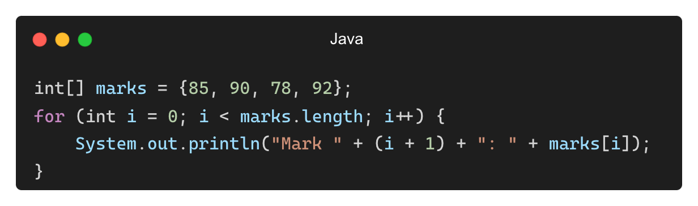
Using length for Dynamic Processing
Looping through an array using length:
Output: Mark 1: 85
Mark 2: 90
Mark 3: 78
Mark 4: 92

Slide 12
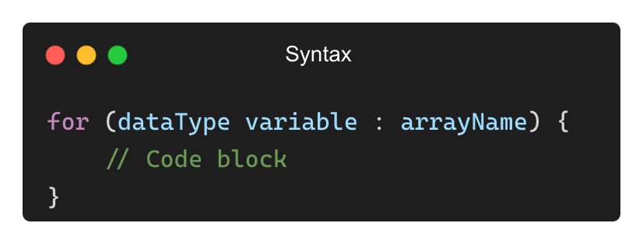
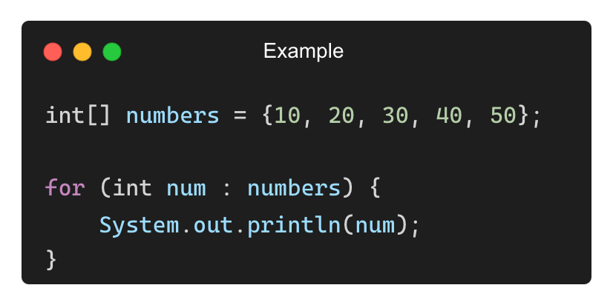
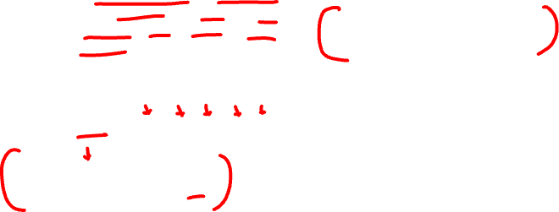
The Enhanced for Loop (for-each Loop)
The enhanced for loop (or for-each) is used for simplified array iteration.
It eliminates the need for an index variable.
Output:
10
20
30
40
50

Slide 13
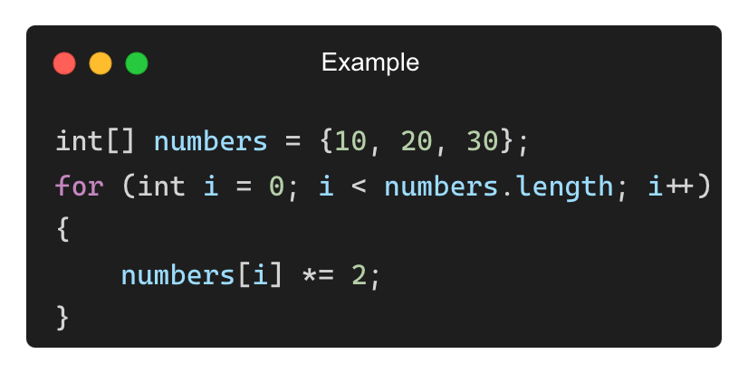
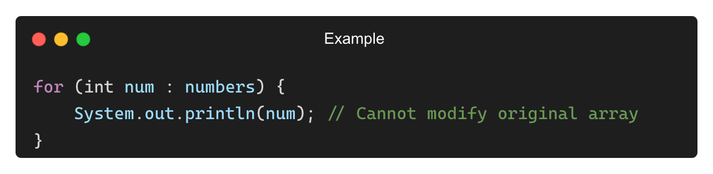
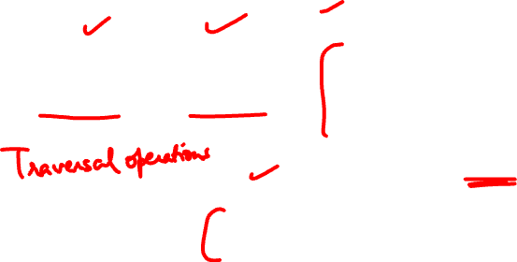
Comparing Traditional vs. Enhanced for Loop
Example (Modifying Elements – Traditional Loop Required)
Feature | Traditional for Loop | Enhanced for Loop
Syntax | Uses index (i) | No index required
Readability | More complex | More Concise
Usage | Modifies array values | Best for read-only operations
Example (Using Enhanced Loop - Read-Only)

Slide 14
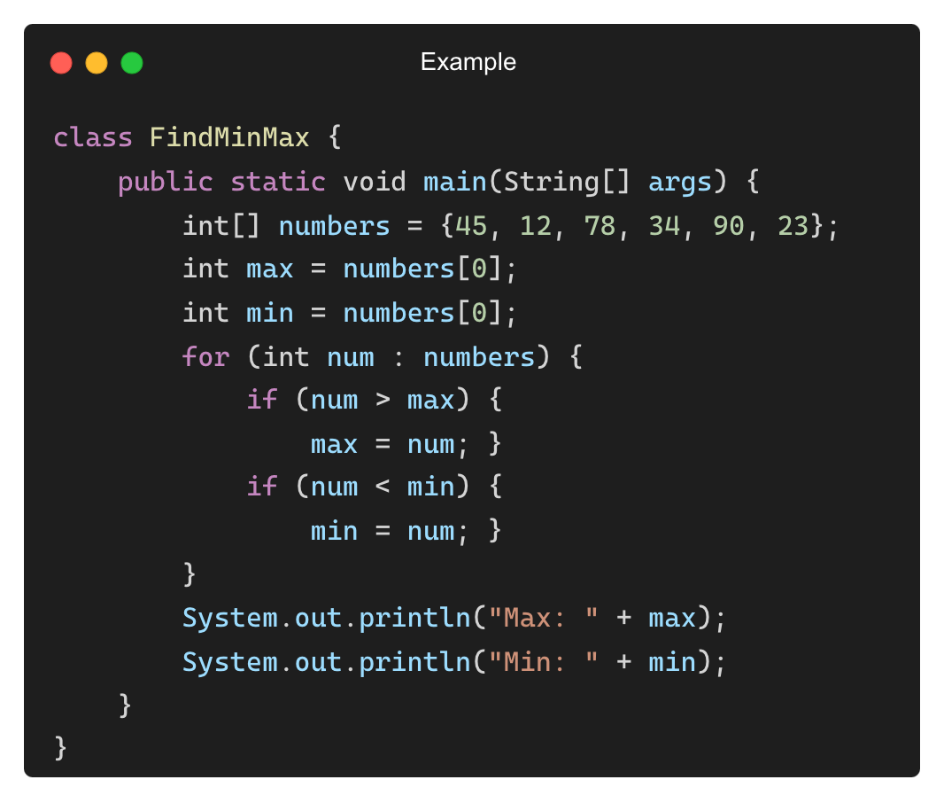
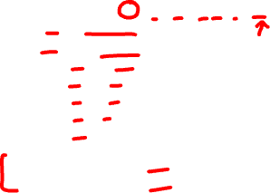
Finding Maximum and Minimum Values Using for-each
Output:
Max: 90
Min: 12

Slide 15
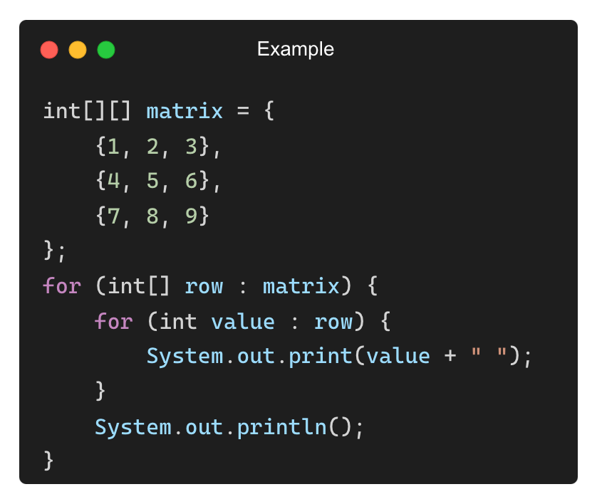
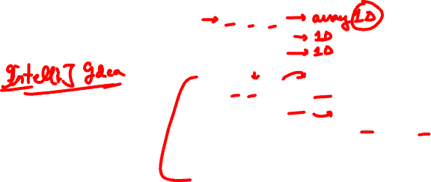
Working with 2D Arrays in an Enhanced Loop
Output:
1 2 3
4 5 6
7 8 9

Slide 16
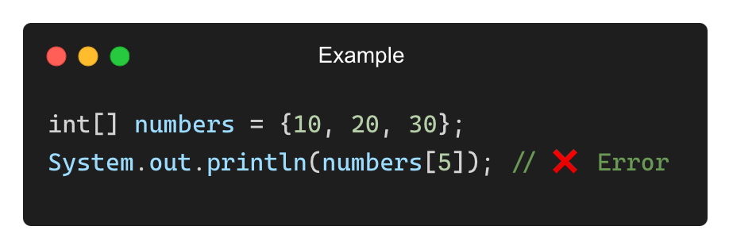
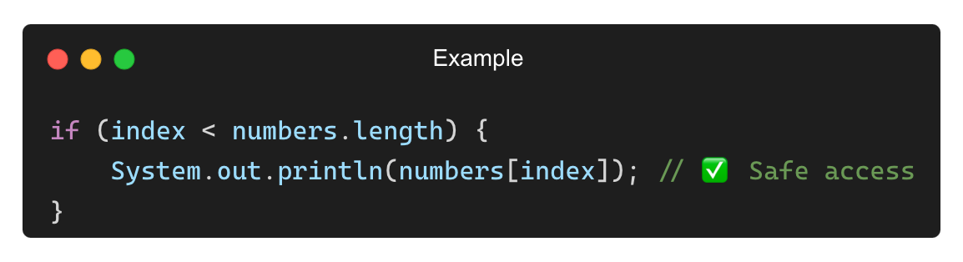
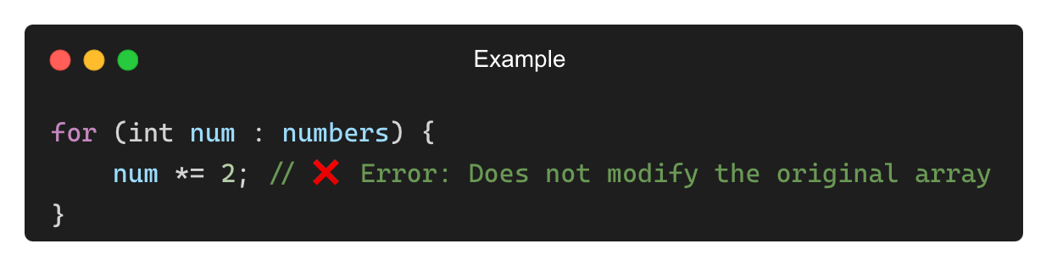
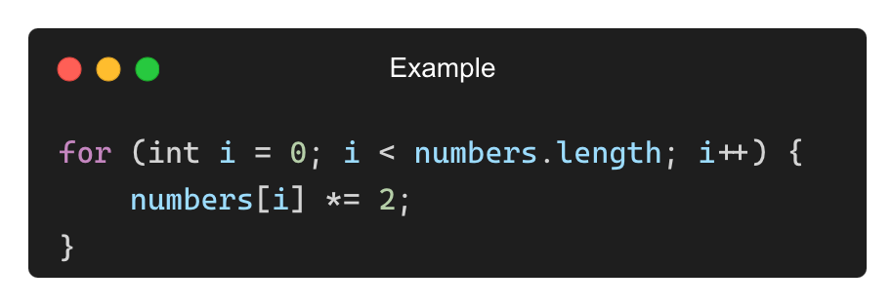
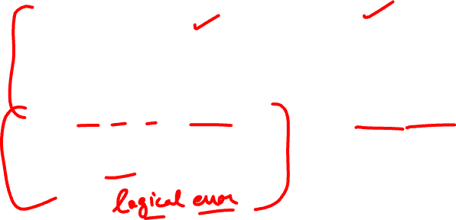
Common Mistakes with length and for-each
❌ Accessing an Index Beyond the Array Size (ArrayIndexOutOfBoundsException)
✅ Solution:
❌ Trying to Modify Array Elements Using for-each Loop
✅ Solution: Use a traditional loop instead:

Slide 17
THANK YOU

